Slide 1
Houdini’s Challenge
Control Webpage

Slide 2
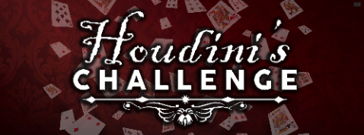

Start 60
Time Left: 24:56
Start 30
Pause
Solve
Reset
Lights:
Red
Green
White
Picture: Mirror:
Current
Remaining
Next Up
Still
in
in
9:56
Houd_15_Left
Hump_Lerk_2
0:12
Hump_Lerk_3
Hint:
Check the desk drawer again.
Send
Functionality:
Start, Pause/Resume, Solve, and Reset buttons.
Light buttons highlight which is active and allow others to be clicked.
Picture and Mirror boxes show what is Current, how long is Remaining the Next Up.
Hint Box (future) allows test to be send to the mirror to be displayed over the clock.

